Slide 1
Java Plays : dashDB and SQL DB Lab
IBM
ECOD

Slide 2
AGENDA
Purpose of This Lab
Managing instances of dashDB
Managing instances of SQL Database
Java Plays : dashDB and SQL DB Lab

Slide 3
Purpose of This Lab
In this lab, you will learn the basics of how to manage dashDB and SQL DB in Bluemix.
After this lab, you will have practical knowledge on how to create an instance of DB in Bluemix,
create a table, browse data, and run SQL script.
Java Plays : dashDB and SQL DB Lab

Slide 4
Managing Instances of dashDB
In this section, you’ll go through the basics of managing dashDB service in IBM Bluemix.
Launch the dashDB console
In your browser go to the Bluemix URL http://bluemix.net and login.
Click on Catalog at the top menu.
Select Data and Analytics option under Services in the left side navigation menu.
click on dashDB.
Java Plays : dashDB and SQL DB Lab

Slide 5
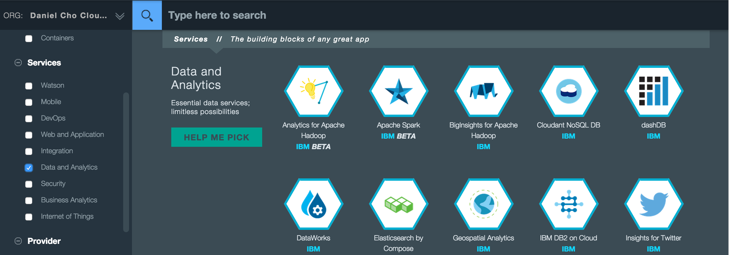
Under App select Leave unbound.
Click on CREATE to create a new instance of dashDB.
Click on Launch when the service’s landing page appears to bring up the dashDB console.
Java Plays : dashDB and SQL DB Lab

Slide 6
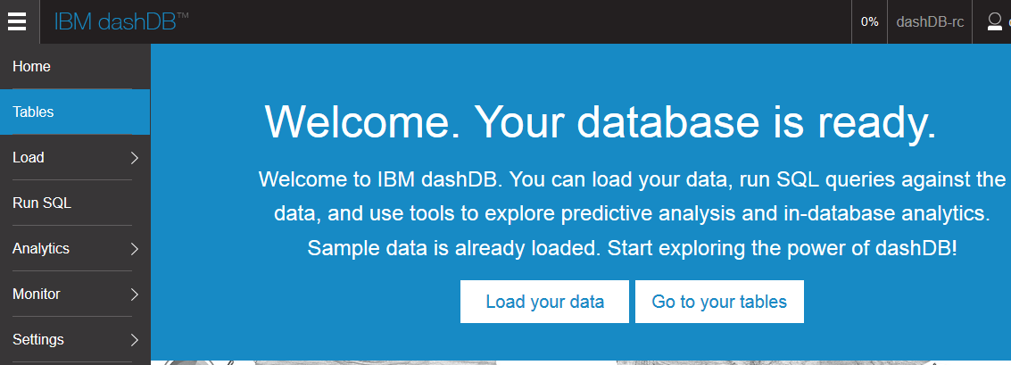
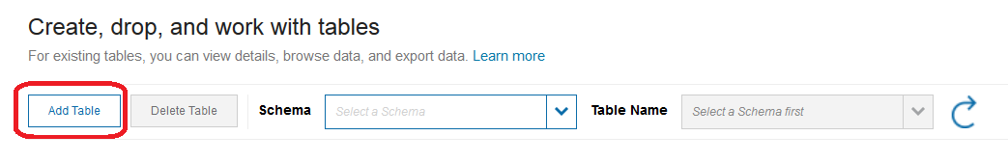
Create a new table
From the dashDB console click on Tables.
Click on Add Table.
Java Plays : dashDB and SQL DB Lab

Slide 7
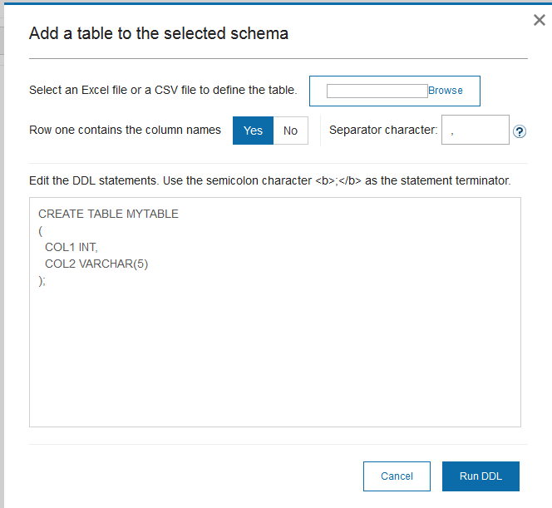
Some sample DDL to create a table is generated for you.
Let’s use the sample DDL to keep things simple. Click Run DDL
Click OK in the dialog that indicates the DDL ran successfully and then click Cancel to exit the dialog with the sample DDL.
Java Plays : dashDB and SQL DB Lab

Slide 8
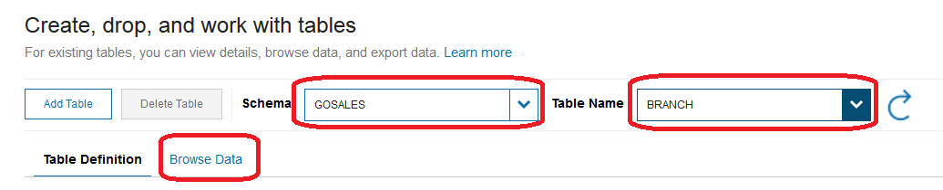
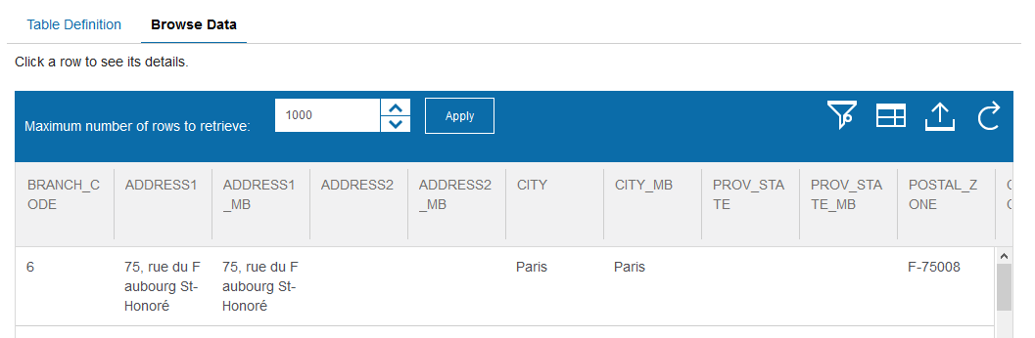
Browse existing table
In the dashDB console select GOSALES as the Schema and BRANCH as the Table Name and then click on Browse Data
Verify that the data in the BRANCH table is displayed.
Java Plays : dashDB and SQL DB Lab

Slide 9
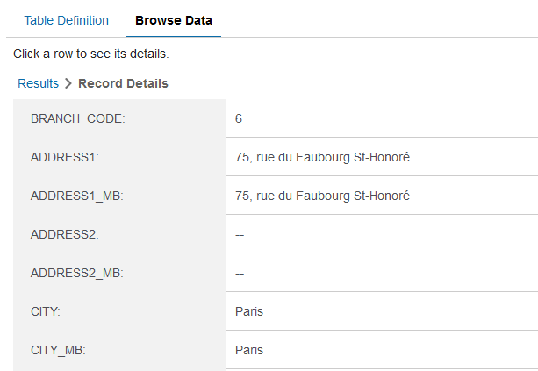
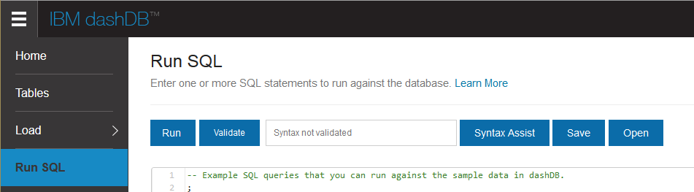
Verify that you can click on a row to see all the data for the row.
Run SQL script
In the dashDB console click on Run SQL in the navigation area on the left.
Java Plays : dashDB and SQL DB Lab

Slide 10
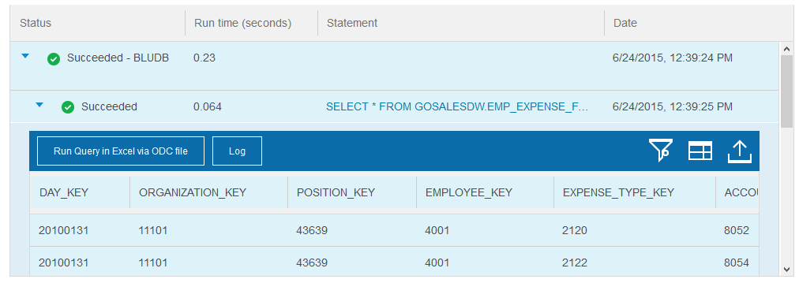
A sample script is preloaded that runs against the sample data in dashDB . Click Run to run the sample script.
Navigate through the results to see the data returned.
Import CSV Data
Download the file IDS_CSV.zip to your local machine from http://databank.worldbank.org/data/download/IDS_CSV.zip This is maintained by the World Bank and has data about each country’s external debt.
Unzip the contents of the file into a folder of your choice.
Java Plays : dashDB and SQL DB Lab

Slide 11
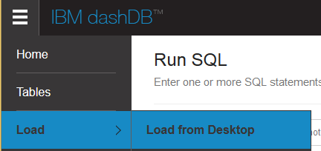
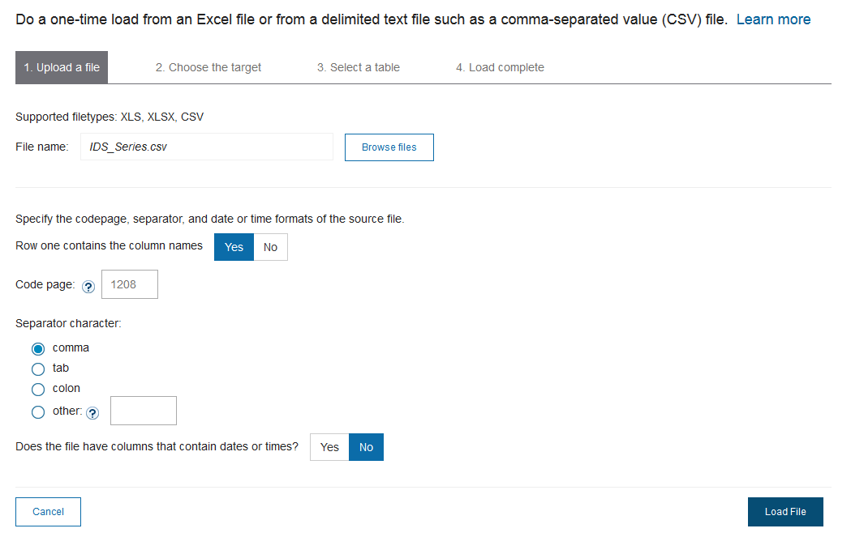
In the dashDB console select Load->Load from Desktop.
Click on Browse files, select IDS_Series.csv (this is one of the files in the zip file downloaded in Step 1) and click on Load File.
Java Plays : dashDB and SQL DB Lab

Slide 12
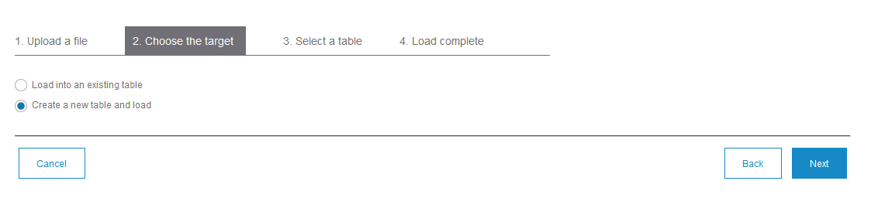
Click Next.
Select Create a new table and load.
Click Next.
Accept the defaults for the new table definition and click Finish.
A preview of the data in the new table will appear as well as the number of rows imported.
Java Plays : dashDB and SQL DB Lab

Slide 13
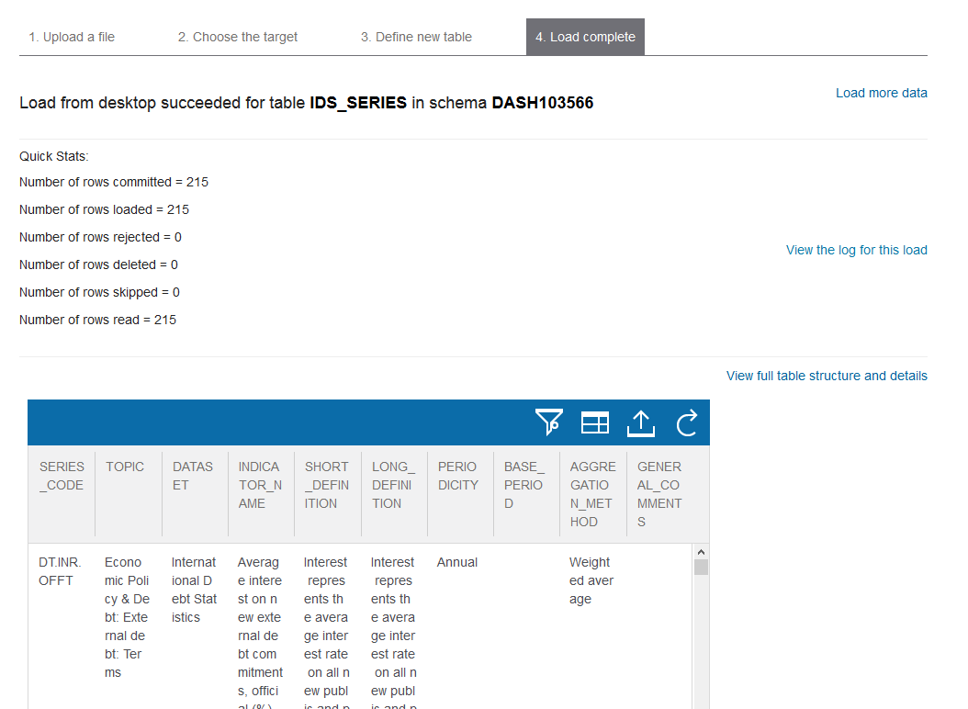
Java Plays : dashDB and SQL DB Lab

Slide 14
Managing Instances of SQL Database
In this section you’ll go through the basics of managing the SQL Database service in IBM Bluemix.
Launch the SQL Database console
In your browser go to the Bluemix URL http://bluemix.net and login.
Click on Catalog at the top menu.
Select Data and Analytics option under Services in the left side navigation menu.
click on SQL Database.
Java Plays : dashDB and SQL DB Lab

Slide 15
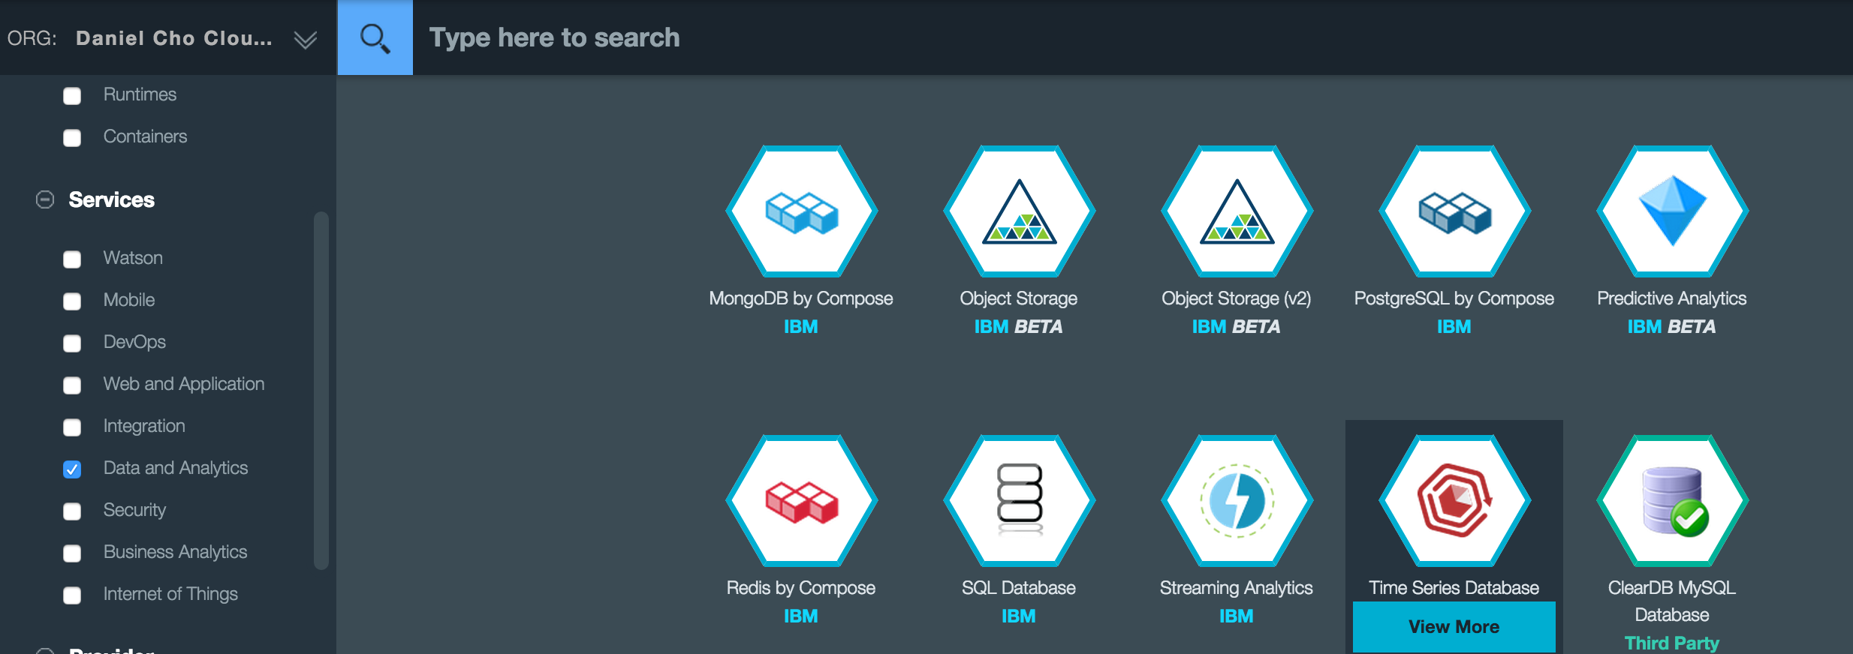
Under App select Leave unbound.
Click on CREATE to create a new instance of SQL Database.
Click Launch when the service landing page appears to launch the dashboard
Java Plays : dashDB and SQL DB Lab

Slide 16
Create a new table
From the SQL Database console click on Work with Tables.
Click on the + icon to enter the SQL DDL to create a new table.
Some example DDL is created, we’ll use that and add a line to insert some data. Add the following line (as shown in the screenshot below) .
INSERT INTO MYTABLE VALUES(1,'Hello');
Java Plays : dashDB and SQL DB Lab

Slide 17
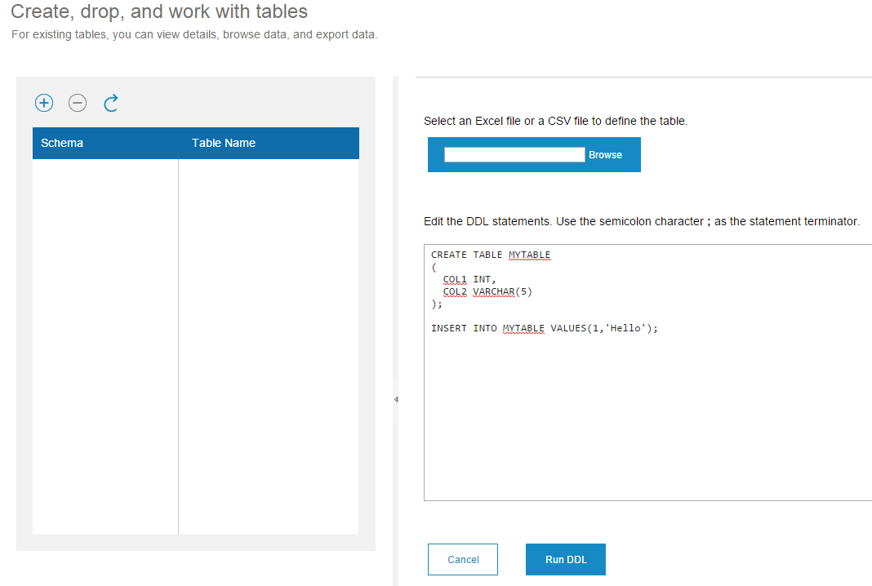
Click Run DDL to create the table.
Java Plays : dashDB and SQL DB Lab

Slide 18
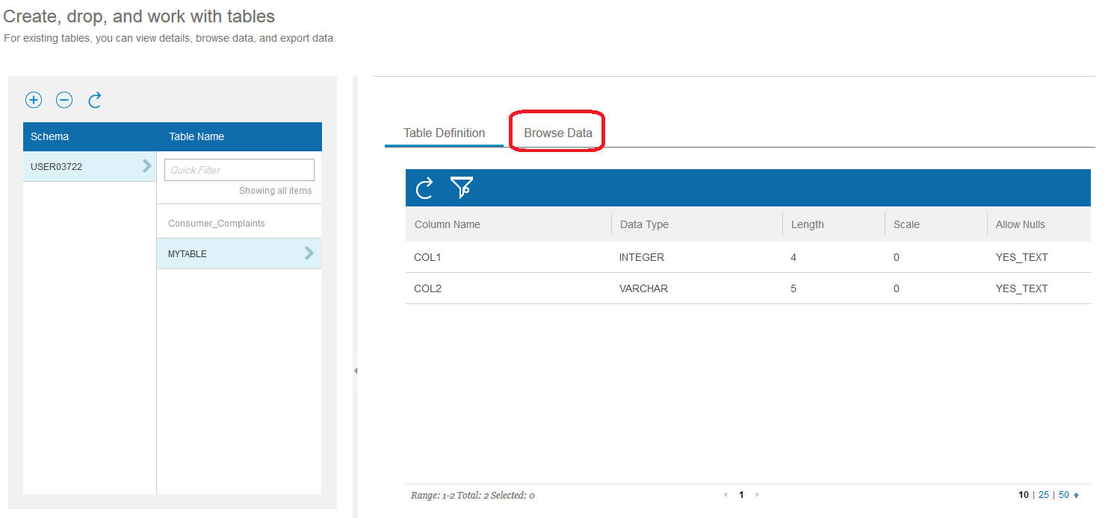
Browse an existing table
In the SQL Database console select your schema and MYTABLE as the Table Name.
Click on Browse Data.
Verify that your single row of data is displayed.
Java Plays : dashDB and SQL DB Lab

Slide 19
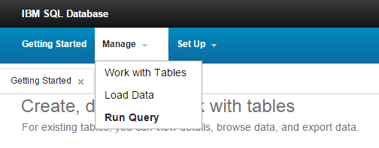
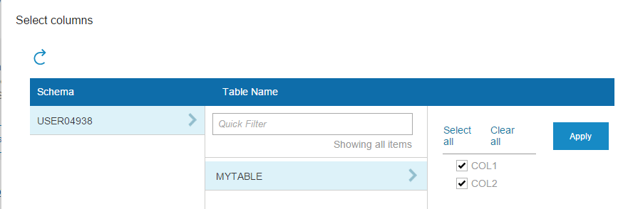
Run SQL scripts
From the SQL Database console navigation menu select Manage->Run Query.
Click Select Tables and Columns.
Java Plays : dashDB and SQL DB Lab

Slide 20
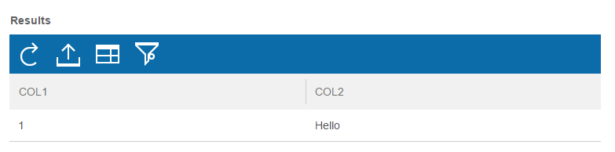
Select your schema and your table and verify that all columns are selected. Click Apply.
Click Run Query.
Verify that the Query results are returned.
Java Plays : dashDB and SQL DB Lab

Slide 21
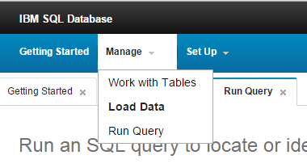
Import CSV data
(Note if you’ve already completed Section 2 of this lab then skip to Step 3) Download the file IDS_CSV.zip to your local machine from http://databank.worldbank.org/data/download/IDS_CSV.zip This is maintained by the World Bank and has data about each country’s external debt.
Unzip the contents of the file into a folder of your choice.
In the SQL Database console select Manage->Load Data.
Java Plays : dashDB and SQL DB Lab

Slide 22
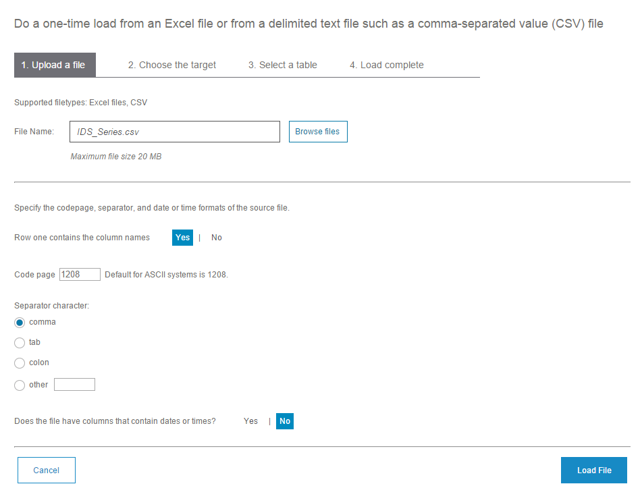
Click on Browse files, select IDS_Series.csv (this is one of the files in the zip file downloaded in Step 1) and click on Load File.
Click Next.
Java Plays : dashDB and SQL DB Lab

Slide 23
Select Create a new table and load.
Click Next.
Accept the defaults for the new table definition and click Finish.
A preview of the data in the new table will appear as well as the number of rows imported.
Java Plays : dashDB and SQL DB Lab

Slide 24
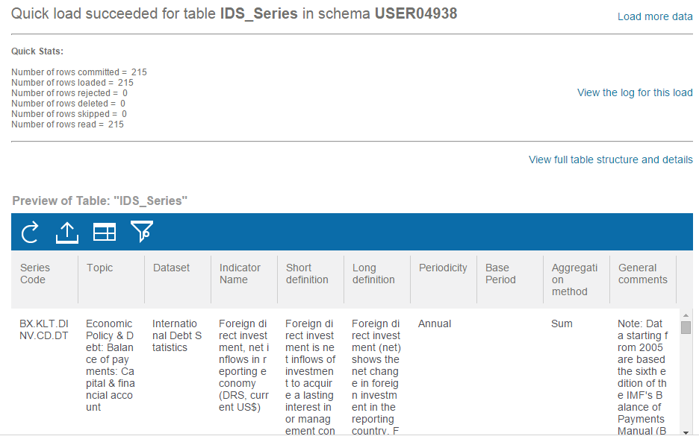
Java Plays : dashDB and SQL DB Lab

Slide 25
This ends dashDB and SQL DB Lab.
Thank you !
Java Plays : dashDB and SQL DB Lab

